Slide 1

Decision Tree
Teoh Teik Toe
ITOM/NBS
ttteoh@ntu.edu.sg
97905202

Slide 2
Objective
Intro to decision tree
Model
Random Forest
XGBoost
Data
Credit Card Upgrade (Classification)
Sharpe Ratio (Regression)
Equity Data (Classification & Regression)
German Credit (Classification)

Slide 3
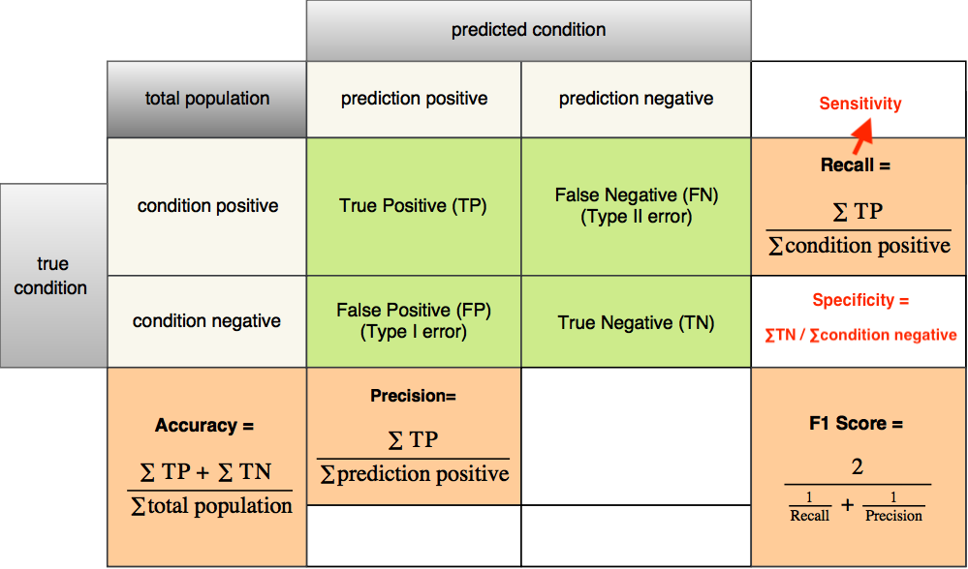
Measurement of a model on test set: Accuracy (For Classifier), for continuous, using RMSE on slide 31
https://images.app.goo.gl/yGHjQrE27emHFTRd7

Slide 4
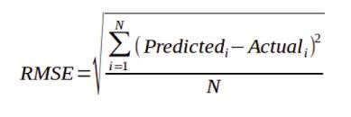
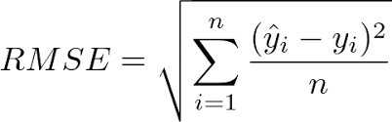
Continuous aka Regression Y
MSE
RMSE

Slide 5
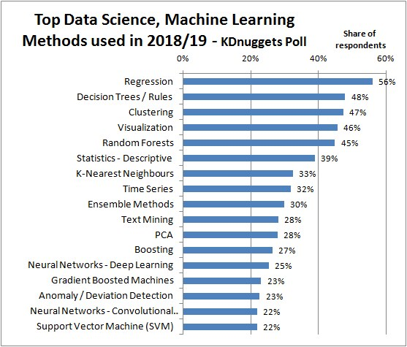
https://images.app.goo.gl/RZL5fApQc5t4syyr5

Slide 6
Reading before class
CART: https://www.dropbox.com/sh/lsjq0p395b9v3hz/AAC5N_k1s4gX-2m4xdjJ25Tka?dl=0
Random Forest : https://www.dropbox.com/sh/egcdse93mjtj6ky/AAC6SkdQoT1oD-oAwSa47u4Qa?dl=0
XGBoost : https://www.dropbox.com/sh/ptjkejw2wbyrqx2/AADS3G0i_l_nhSChRtmpP4i4a?dl=0

Slide 7

Decision Tree – Definition
A decision tree is a decision support tool that uses a tree-like model of decisions and their possible consequences, including chance event outcomes, resource costs, and utility.

Slide 8
Application
Operations research
Customer Relationship Management - How individuals access online services, providing recommendations
Detection of Fraudulent Financial Statements (FFS).

Slide 9
CART, Random Forest, XGBoost
CART Classification and Regression Trees
Random Forest
XGBoost - Extreme Gradient Boosting

Slide 10
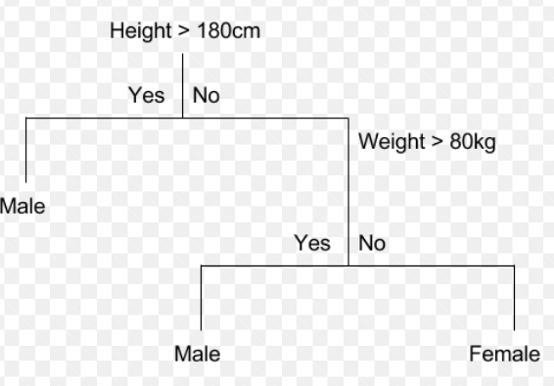
CART

Slide 11
Decision Tree Algorithm (1 Independent Variable X and 1 Dependent Variable Y)
Female
Male
Height
1.7M
Female
Male
Gender
Height > 1.7m
1.63m (average of female height)
1.73m (average of male height)
Male
Female
Use height (X) to classified gender (Y)
Classification or Categorical Y
Use gender (X) to predict Height (Y)
(Regression or Continuous Y)

Slide 12
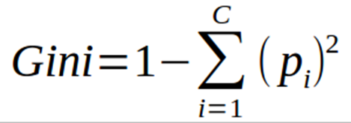
2 Independent Variable, which will be at higher node
Depends on impurity, measurement is GINI – The higher the impurity, the higher GINI and the lower the node in hierarchy (not a good feature) and Vice Versa. Example below, height will be at higher level.
Female
Male
Height
Female
Male
Weight

Slide 13
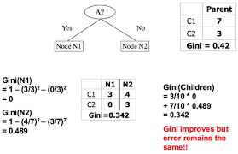
Gini Index – A is “budget”, N1 “Shopping”

Slide 14
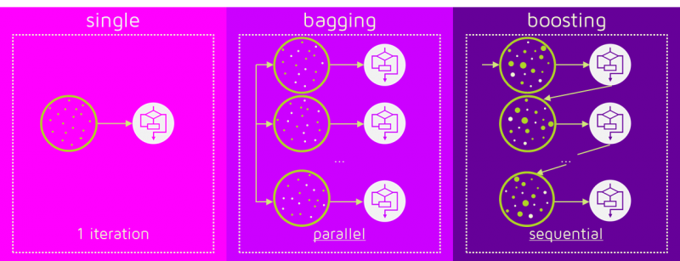
Bagging (Random Forest) & Boosting (XGBoost)
https://images.app.goo.gl/QsNjBambxZRSxyYF9

Slide 15
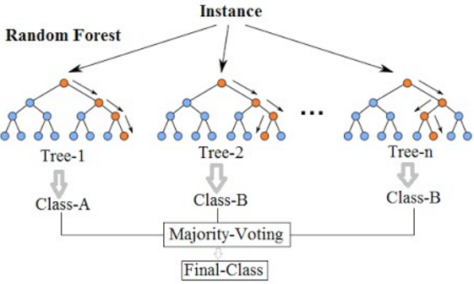
Random Forest

Slide 16
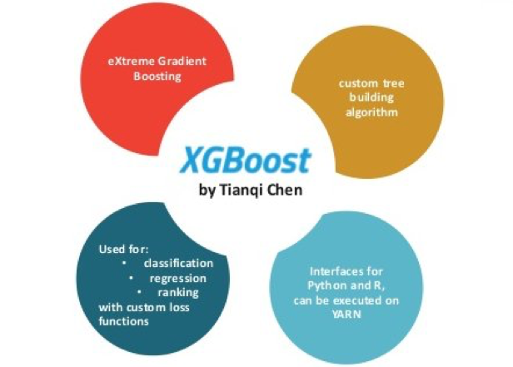
XGBoost
https://www.kdnuggets.com/2020/12/xgboost-what-when.html

Slide 17
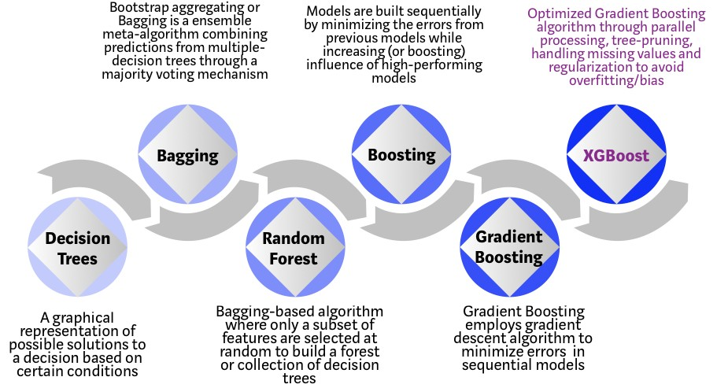
XGBoost
https://towardsdatascience.com/https-medium-com-vishalmorde-xgboost-algorithm-long-she-may-rein-edd9f99be63d

Slide 18
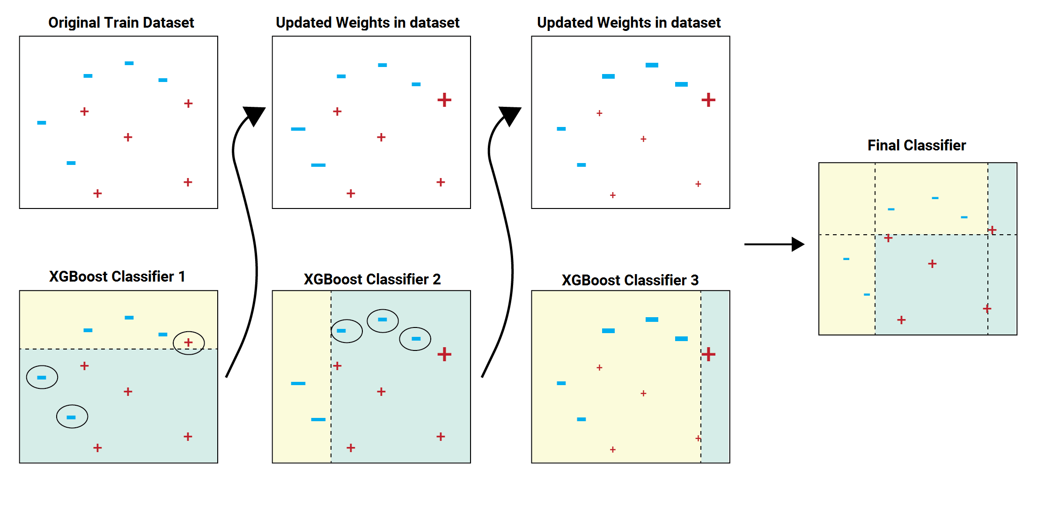
Gradient Boosting Algo – Train on Residual (increase the weight for error data)

Slide 19
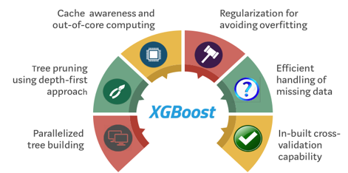
Why & What Extreme?
“XGBoost” = Regularized gradient boosting?
Learning Rate
Pruning
Cross Validation
Depth
Min Split
Train on Residual
Impute Missing Value
Penalises complexity

Slide 20
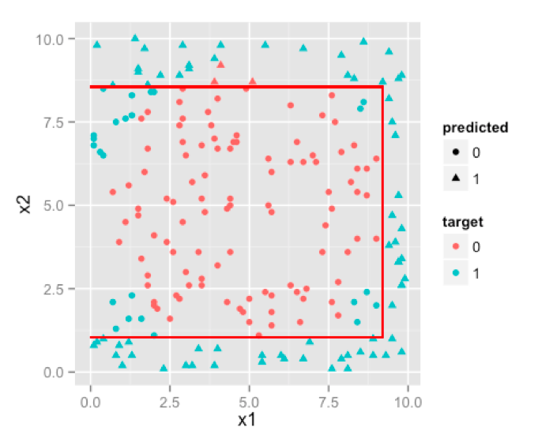
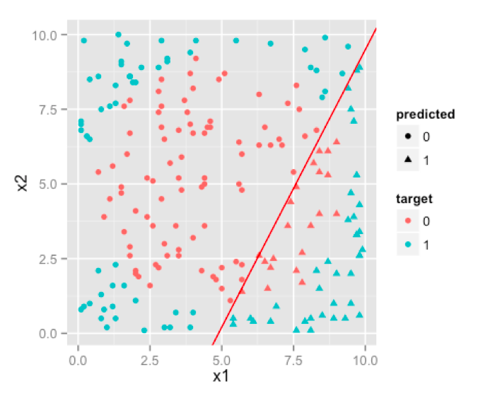
Decision Tree vs Regression
https://images.app.goo.gl/bxDBHJMEUVSCvFFL9

Slide 21
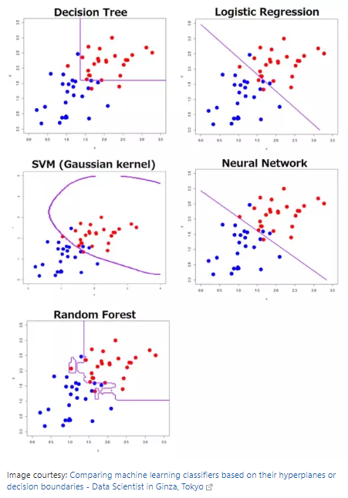
Decision Tree vs Others

Slide 22
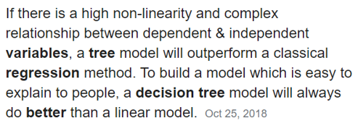
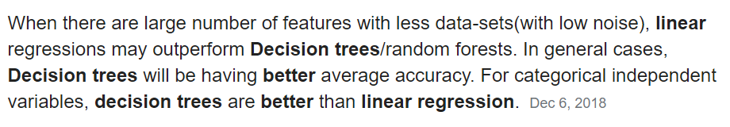
Comparison : Regression vs Decision Tree

Slide 23
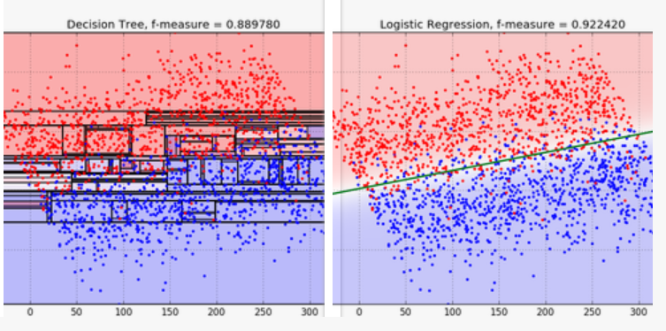
When is regression better than decision tree
https://blog.bigml.com/2016/09/28/logistic-regression-versus-decision-trees/#:~:text=Decision%20Trees%20bisect%20the%20space,generalize%20to%20planes%20and%20hyperplanes.

Slide 24
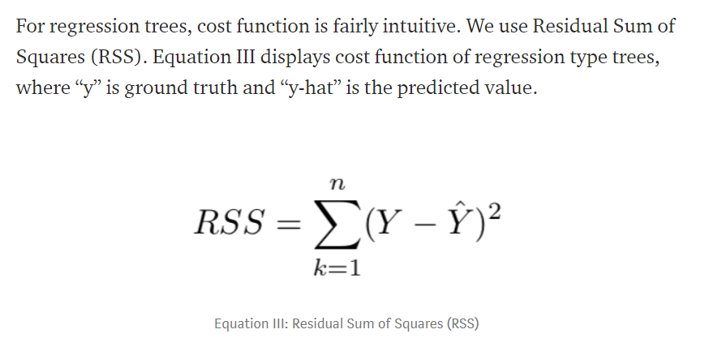
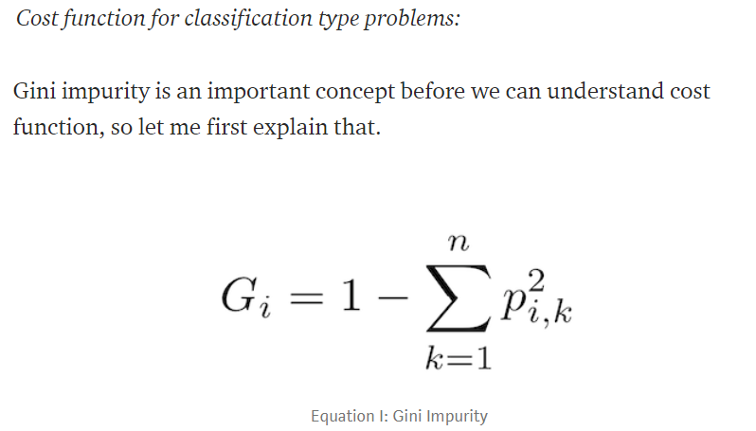
Hottest Question on Decision Tree
Can you explain cost function of decision trees?
For selection of attribute at which nodes.
For testing of the tree performance

Slide 25
Which Model and When to Stop (avoid overfitting)
Which Model and When to Stop (avoid overfitting)
Regression:
lm using Rsq
Glm using AIC
Decision Tree
CART Using Complexity Parameter
Random Forest – 500 trees
XGBoost – each tree has 6 layers 100 trees
Neural Network
Complex algorithm (many) Next Week

Slide 26

Advantages of Decision Trees
Decision trees generate understandable rules.
Decision trees are capable of handling both continuous and categorical variables.
Decision trees provide a clear indication of which fields are most important for prediction or classification.

Slide 27
Advantages & Disadvantages of Decision Trees
Less appropriate for a continuous attribute.
The process of growing a decision tree is computationally expensive. At each node, each candidate splitting field must be sorted before its best split can be found.
Overfitting problem

Slide 28
Common terms used with Decision trees:
Root Node: It represents entire population or sample and this further gets divided into two or more homogeneous sets.
Splitting: It is a process of dividing a node into two or more sub-nodes.
Decision Node: When a sub-node splits into further sub-nodes, then it is called decision node.
Leaf/ Terminal Node: Nodes do not split is called Leaf or Terminal node.
Pruning: When we remove sub-nodes of a decision node, this process is called pruning. You can say opposite process of splitting.

Slide 29
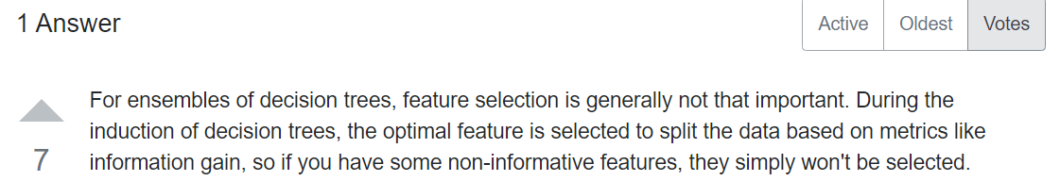
Does feature selections matter to Decision Tree algorithms?
https://datascience.stackexchange.com/questions/51615/does-feature-selections-matter-to-decision-tree-algorithms

Slide 30
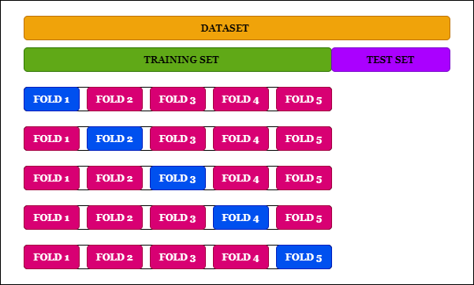
Cross Validation

Slide 31
Credit Card Upgrade

Slide 32
Decision Tree – Credit Card Upgrade
Classification and Regression Tree (CART)
Can be applied for either continuous or categorical Y.
Results and Interpretation [High explanability]
Phrase 1: Grow the Tree
Phrase 2: Prune the Tree
Selecting the “best” Tree

Slide 33
Decision Tree Using R - rpart
30 rows of data

Slide 34
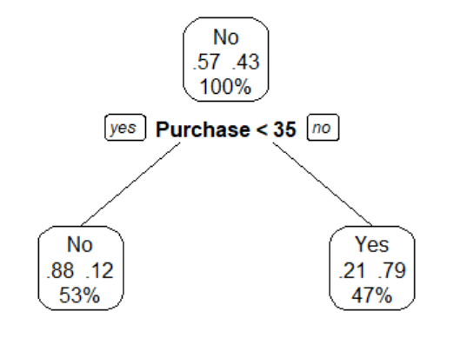
d = read.csv("CreditCardUpgrade.csv")
summary(d)
d$Upgraded = factor(d$Upgraded, levels = c(0,1), labels = c("No", "Yes"))
d$SuppCard = factor(d$SuppCard, levels = c(0,1), labels = c("No", "Yes"))
library(rpart) # recursive partitioning and CART (classification and regression trees
library(rpart.plot)
set.seed(2)
model = rpart(d$Upgraded ~ .,data=d)
#https://www.rdocumentation.org/packages/rpart.plot/versions/3.0.9/topics/rpart.plot
prp(model, type = 2, extra = 4)
pred = predict(model, newdata = d, type = "class")
print(pred)
cm = table(d$Upgraded, pred)
print(cm)
plotcp(model)
# to find out split : model[["splits"]]

Slide 35
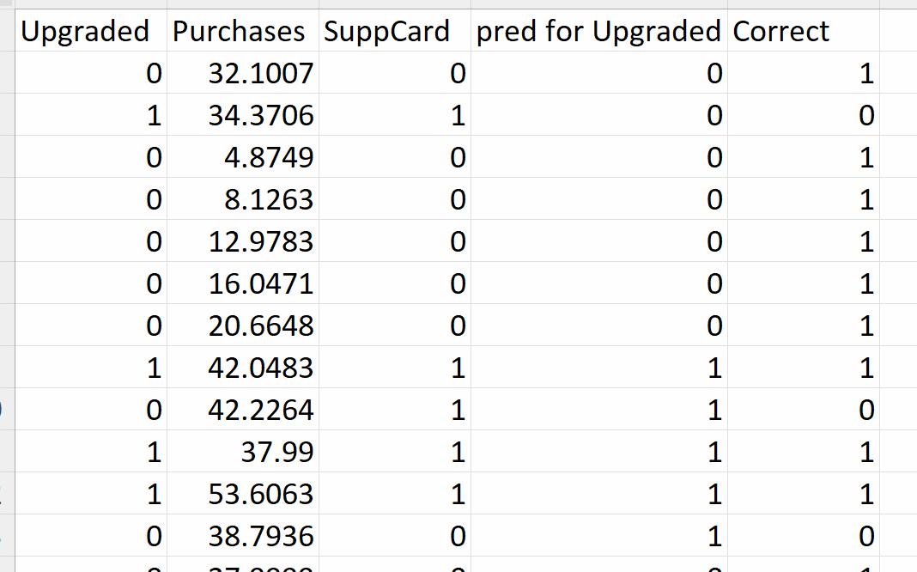
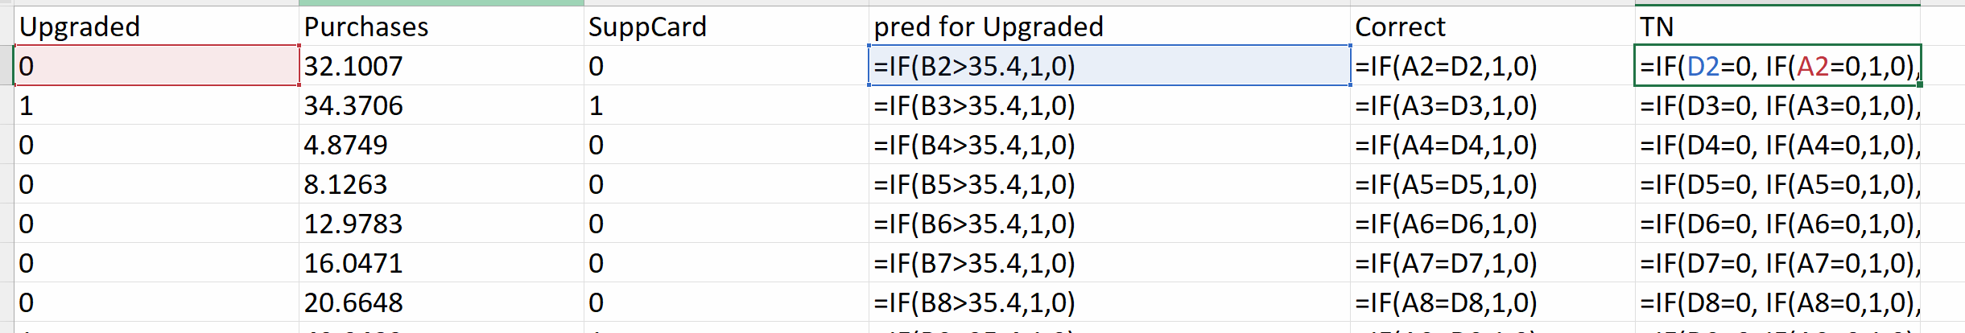
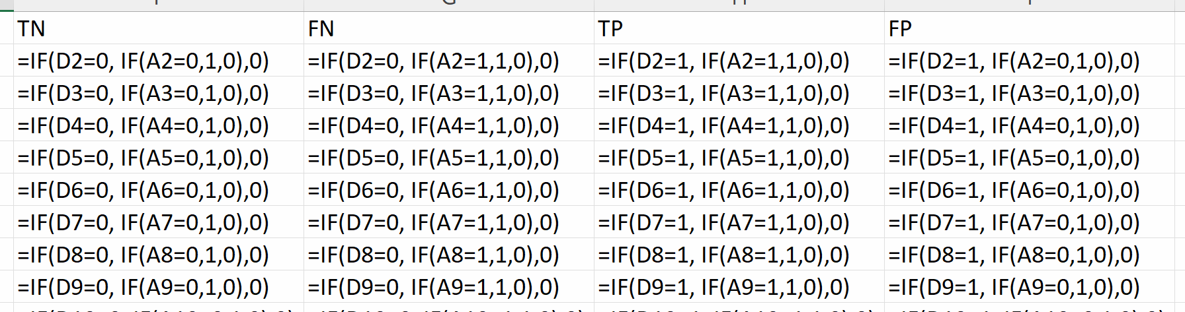
Use excel

Slide 36
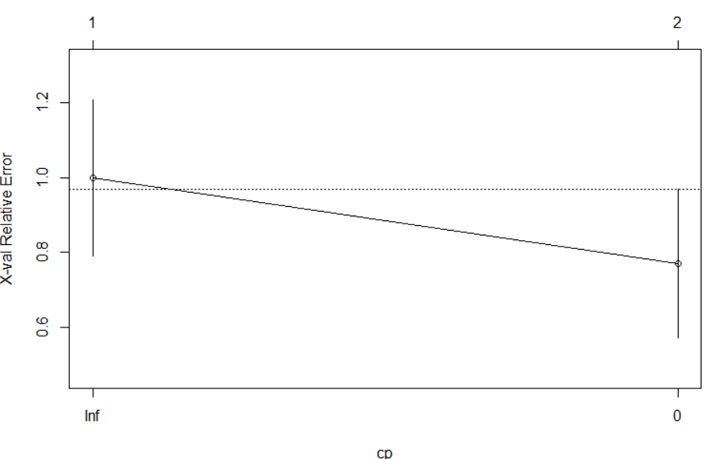
Should you Prune the tree? No if the error is dropping

Slide 37
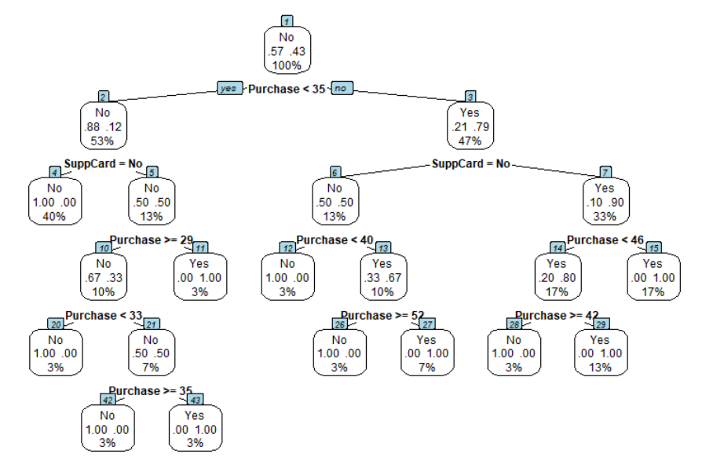
Activity 2: M2: Grow the Tree
model = rpart(d$Upgraded ~ ., data=d, control = rpart.control(minsplit = 2))
prp(model, type =2, extra = 104)
pred = predict(model, newdata = d, type = "class")
print(pred)
cm = table(pred, d$Upgraded)
print(cm)
plotcp(model)

Slide 38
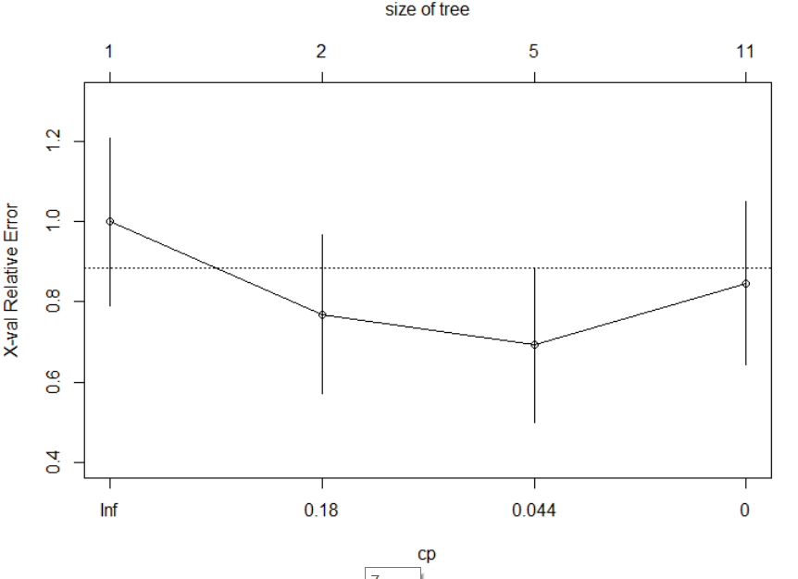
Prune The Tree for M2? Yes, error goes up after 0.044

Slide 39
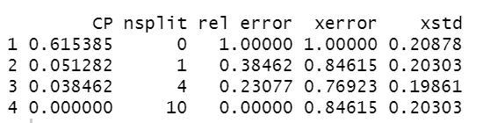
Activity 3: M3 Pruned the tree
# Find Optimum CP
printcp(model)

Slide 40
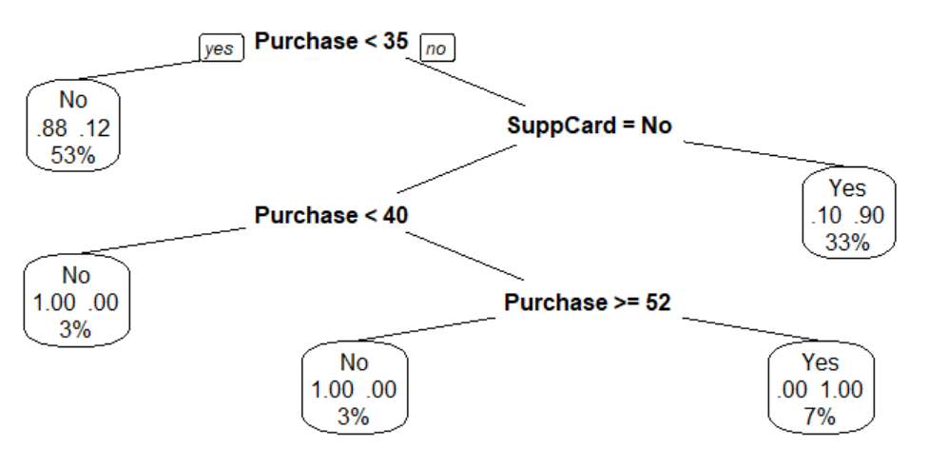
After prune at CP Optimum
# Prune the max tree m2 using a particular CP value
model = prune(model, cp = 0.038462)
prp(model, type=0, extra=104)
plotcp(model)
pred = predict(model, newdata = d, type="class")
table(d$Upgraded, pred)

Slide 41
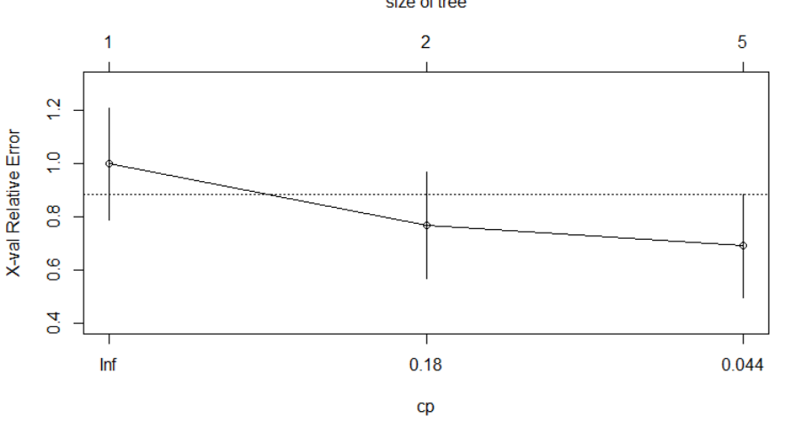
Prune The Tree for M3? No need to Prune, error did not go up

Slide 42
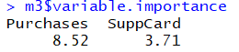
Feature Engineering - Ranking, Purchase more important than SuppCard
model$variable.importance

Slide 43
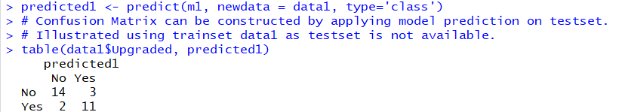
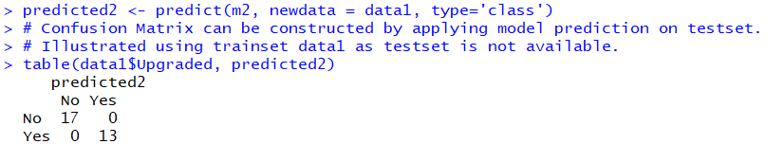
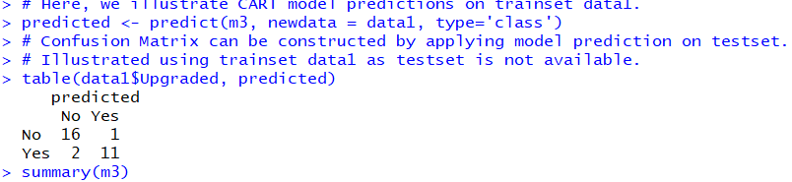
Activity 4 : Compare the final Results
Model 2 has zero error but model 3 has 3 error, which is better?

Slide 44
Python
import pandas as pd
df = pd.read_csv("C:/Users/Teoh Teik Teo/OneDrive - TSS Global Pte. Ltd/TT Library/AI Model/Data/CreditCardUpgrade.csv")
print(df)
X = df.loc[:,["Purchases", "SuppCard"]]
Y = df.loc[:,"Upgraded"]
print(X,Y)
from sklearn import tree
#https://scikit-learn.org/stable/modules/generated/sklearn.tree.DecisionTreeClassifier.html
model = tree.DecisionTreeClassifier(max_depth=3)
model.fit(X, Y)
pred = model.predict(X)
from sklearn.metrics import confusion_matrix
cm = confusion_matrix(Y, pred)
print(cm)
accuracy = (cm[0,0] + cm[1,1])/sum(sum(cm))
print(accuracy)

Slide 45
Use Grid (max depth, min sample split)
import math
from sklearn.model_selection import GridSearchCV
model = tree.DecisionTreeClassifier()
grid = GridSearchCV(estimator = model, param_grid = dict(max_depth = [i for i in range(1, 20)]))
grid_results = grid.fit(X, Y)
grid_results.best_params_
import math
from sklearn.model_selection import GridSearchCV
model = tree.DecisionTreeClassifier()
grid = GridSearchCV(estimator = model, param_grid = dict( min_samples_split = [i for i in range(3, 20)]))
grid_results = grid.fit(X, Y)
grid_results.best_params_

Slide 46
Sharpe Ratio

Slide 47
import pandas as pd
df = pd.read_csv("Sharpe.csv")
df=df.dropna()
df.describe()
X=df.iloc[:,3:7]
Y=df.iloc[:,2]
print(X,Y)
from sklearn.model_selection import train_test_split
X_train,X_test,Y_train,Y_test = train_test_split(X,Y, test_size=0.3)
from sklearn import tree
model = tree.DecisionTreeRegressor(max_depth=6)
model.fit(X_train, Y_train)
pred = model.predict(X_train)
from sklearn.metrics import mean_squared_error
rmse = mean_squared_error(pred, Y_train)**0.5
print(rmse)
pred = model.predict(X_test)
rmse = mean_squared_error(pred, Y_test)**0.5
print(rmse)

Slide 48
Save model and load model
# save the model to disk
import pickle
#filename = 'finalized_model.sav'
pickle.dump(model, open(“sharpe_decisiontree, 'wb'))
# load the model from disk and predict from existing to validate the load
model1 = pickle.load(open('finalized_model.sav', 'rb’))
#pred = model1.predict(X_test)
#rmse = mean_squared_error(pred, Y_test)**0.5
#print(rmse)
#predict one row
X_test = [[0.04, 7000, 15, 1.4]]
pred = model1.predict(X_test)
print(pred)

Slide 49
Optional Prediction only (new data)
df = pd.read_csv("Sharpe (Predict).csv")
X_predict=df.iloc[:,3:7]
X_predict = X_predict.dropna()
# load the model from disk
pred = model1.predict(X_predict)
print(pred)

Slide 50
Create Validation Set
# for optimization
X_train1, X_validate, Y_train1, Y_validate = train_test_split(X_train, Y_train, test_size=0.2)

Slide 51
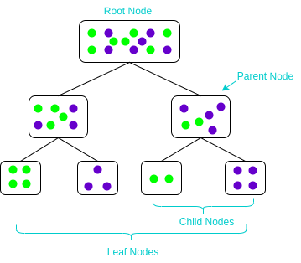
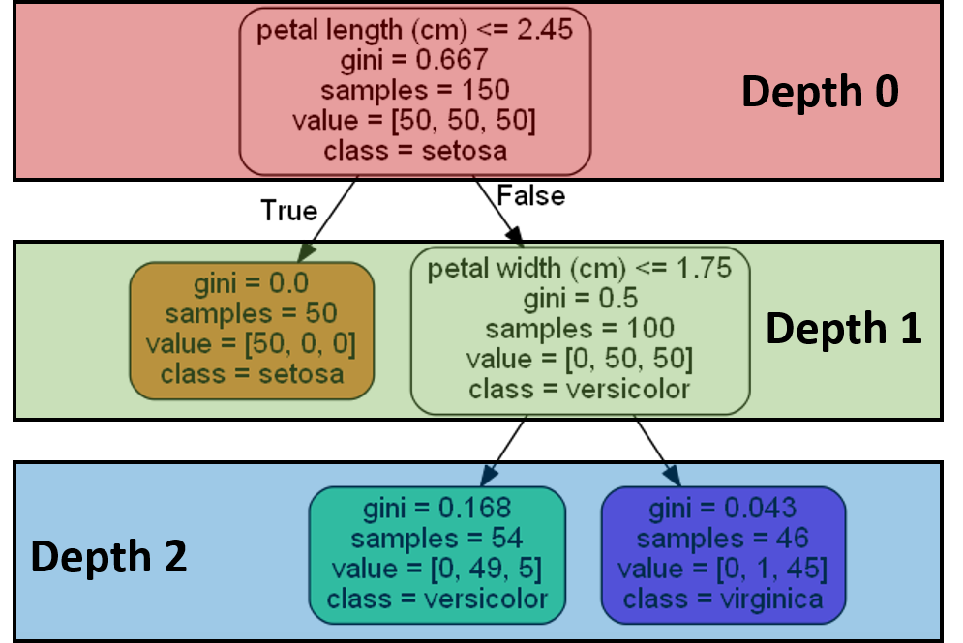
Optimization (max_depth, min_split)
for i in range(100):
print(i)
model = DecisionTreeRegressor(min_samples_split = i+2)
model.fit(X_train1, Y_train1)
pred = model.predict(X_validate)
rmse = mean_squared_error(Y_validate, pred) ** 0.5
print(rmse)

Slide 52
Use Grid (max depth, min sample split)
import math
from sklearn.model_selection import GridSearchCV
model = tree.DecisionTreeClassifier()
grid = GridSearchCV(estimator = model, param_grid = dict(max_depth = [i for i in range(1, 20)]))
r= grid.fit(X, Y)
r.best_params_
import math
from sklearn.model_selection import GridSearchCV
model = tree.DecisionTreeClassifier()
grid = GridSearchCV(estimator = model, param_grid = dict( min_samples_split = [i for i in range(3, 20)]))
grid_results = grid.fit(X, Y)
grid_results.best_params_

Slide 53
Max Depth with Graphs
j=[]
r = [0] * 20
for i in range(20):
print(i)
j.append(i)
model = tree.DecisionTreeRegressor(max_depth = i+1)
model.fit(X_train1, Y_train1)
pred = model.predict(X_validate)
rmse = mean_squared_error(Y_validate, pred) ** 0.5
print(rmse)
r[i]=rmse
print("===")
print(j)
import matplotlib.pyplot as plt
plt.plot(j, r)
plt.xlabel('parameter')
plt.ylabel('rmse')
plt.title('rmse')
plt.show()
Need to run the 5 lines code together

Slide 54
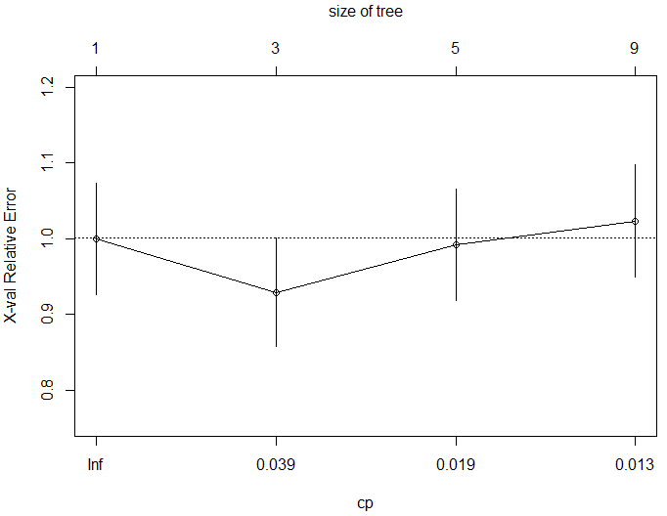
Optional: CP optimum
path = model.cost_complexity_pruning_path(X_train1, Y_train1)
#ccp_alphas, impurities = path.ccp_alphas, path.impurities
#print(ccp_alphas, impurities)
for i in path.ccp_alphas:
print(i)
model = tree.DecisionTreeRegressor(ccp_alpha=i)
model.fit(X_train1, Y_train1)
pred = model.predict(X_validate)
rmse = mean_squared_error(Y_validate, pred) ** 0.5
print(rmse)
print("====")

Slide 55
Feature Ranking & Plot Tree
fr = model.feature_importances_
print(fr)
import matplotlib.pyplot as plt
plt.subplots(figsize=(20, 10))
tree.plot_tree(model, fontsize=10)
This 2 lines of code MUST JOIN

Slide 56
Regression (for comparison)
from sklearn import linear_model
model = linear_model.LinearRegression()
model.fit(X_train, Y_train)
pred = model.predict(X_train)
rmse = mean_squared_error(pred, Y_train)
print(rmse)
pred = model.predict(X_test)
rmse = mean_squared_error(pred, Y_test)
print(rmse)

Slide 57
Random Forest
from sklearn.ensemble import RandomForestRegressor
model = RandomForestRegressor(max_depth=2)
model.fit(X_train, Y_train)
pred = model.predict(X_train)
from sklearn.metrics import mean_squared_error
rmse = mean_squared_error(pred, Y_train)**0.5
print(rmse)
pred = model.predict(X_test)
rmse = mean_squared_error(pred, Y_test)**0.5
print(rmse)

Slide 58
XGBoost
from sklearn.ensemble import GradientBoostingRegressor
model = GradientBoostingRegressor(max_depth=2)
model.fit(X_train, Y_train)
pred = model.predict(X_train)
from sklearn.metrics import mean_squared_error
rmse = mean_squared_error(pred, Y_train)**0.5
print(rmse)
pred = model.predict(X_test)
rmse = mean_squared_error(pred, Y_test)**0.5
print(rmse)

Slide 59
Compare with Linear Regression Model
from sklearn import linear_model
model = linear_model.LinearRegression()
model.fit(X_train, Y_train)
pred = model.predict(X_train)
rmse = mean_squared_error(Y_train, pred) ** 0.5
print(rmse)
pred = model.predict(X_test)
rmse = mean_squared_error(Y_test, pred) ** 0.5
print(rmse)

Slide 60
Optional : Predict Tesla Beta
import pandas as pd
df = pd.read_csv("Sharpe.csv")
df=df.dropna()
df.describe()
X=df.iloc[:,3:6]
Y=df.iloc[:,6]
print(X,Y)
from sklearn.model_selection import train_test_split
X_train,X_test,Y_train,Y_test = train_test_split(X,Y, test_size=0.3)
from sklearn import tree
model = tree.DecisionTreeRegressor(max_depth=6)
model.fit(X_train, Y_train)
pred = model.predict(X_train)
from sklearn.metrics import mean_squared_error
rmse = mean_squared_error(pred, Y_train)**0.5
print(rmse)
pred = model.predict(X_test)
rmse = mean_squared_error(pred, Y_test)**0.5
print(rmse)

Slide 61
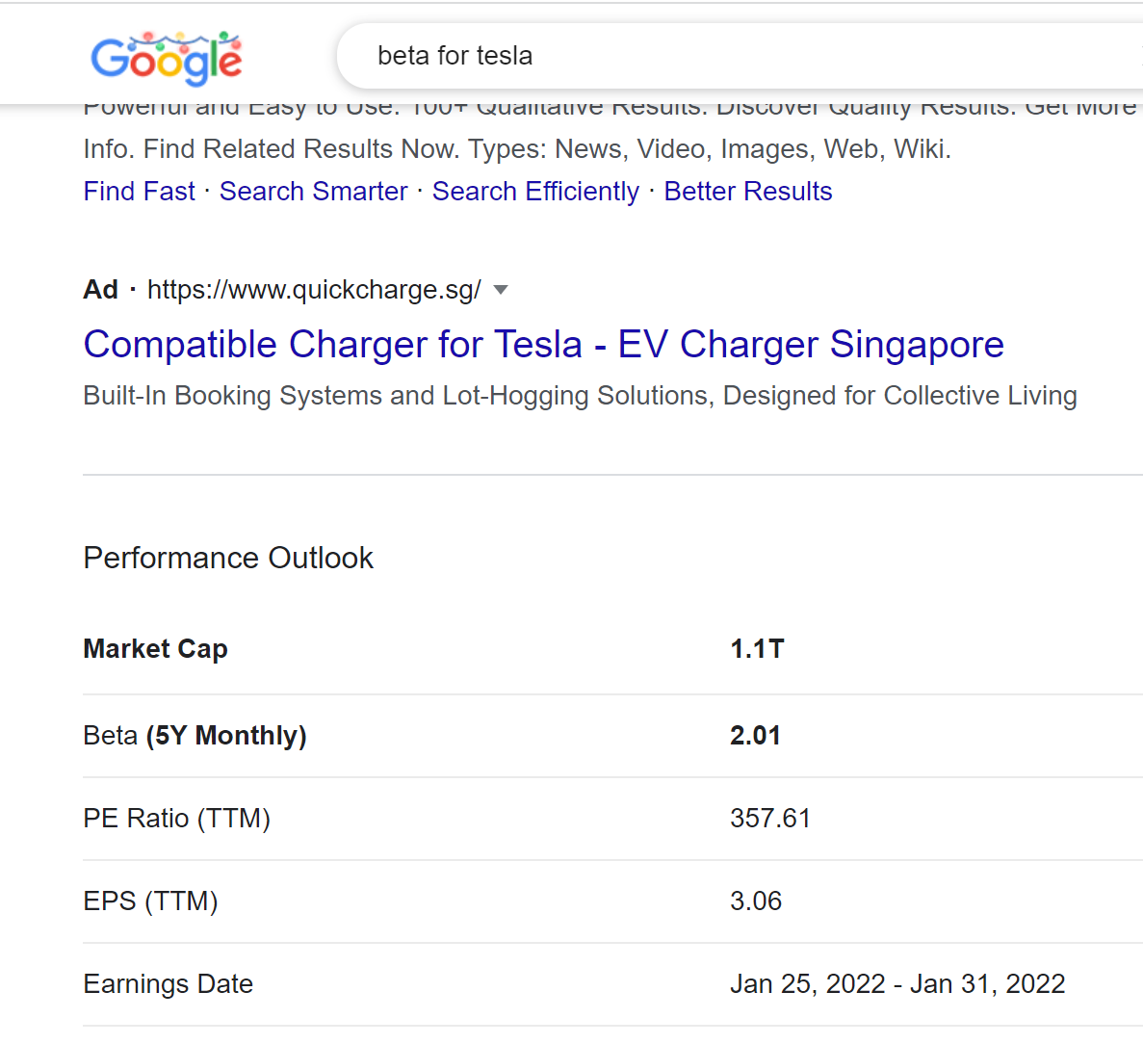
Predict Tesla Beta
# save the model to disk
import pickle
filename = 'finalized_model.sav'
pickle.dump(model, open(filename, 'wb'))
# load the model from disk
model1 = pickle.load(open('finalized_model.sav', 'rb’))
X_test = [[0, 1100000, 357]]
pred = model1.predict(X_test)
print(pred)

Slide 62
Optional : Predict Tesla PE using Equity Data
import pandas as pd
df = pd.read_csv("Equity.csv")
# pd.set_option('display.max_columns', None)
# pd.set_option('display.max_rows', None)
for i in df.columns:
print(i)
cor = df.corr()
cor = abs(cor["priceEarningsRatio"])
#Selecting highly correlated features
f = cor[cor>0.1]
print(f.sort_values())
pd.set_option('display.max_rows', None)
n= df.isnull().sum().sort_values()
print(n)
df = df.loc[:, ["priceEarningsRatio", "10Y Net Income Growth (per Share)", "Receivables Turnover"]]

Slide 63
df = df.dropna()
#split X,Y
Y = df.iloc[:, 0]
X = df.iloc[:, 1:3]
from sklearn.model_selection import train_test_split
X_train, X_test, Y_train, Y_test = train_test_split(X,Y, test_size=0.3)
print(X_train, X_test, Y_train, Y_test )
from sklearn import tree
model = tree.DecisionTreeRegressor(max_depth=5)
model.fit(X_train, Y_train)
pred = model.predict(X_train)
from sklearn.metrics import mean_squared_error
rmse = mean_squared_error(Y_train, pred) ** 0.5
print(rmse)
pred = model.predict(X_test)
rmse = mean_squared_error(Y_test, pred) ** 0.5
print(rmse)

Slide 64
# save the model to disk
import pickle
filename = "decisionTree.sav"
pickle.dump(model, open(filename, 'wb'))
# load the model from disk
model1 = pickle.load(open("decisionTree.sav", 'rb'))
#predict one row
X_test = [[0.16, 4]]
pred = model1.predict(X_test)
print(pred)

Slide 65
Optional : Regression for Comparison
from sklearn.model_selection import train_test_split
X_train, X_test, Y_train, Y_test = train_test_split(X,Y, test_size=0.3)
print(X_train, X_test, Y_train, Y_test )
from sklearn import linear_model
model = linear_model.LinearRegression()
model.fit(X_train, Y_train)
pred = model.predict(X_train)
from sklearn.metrics import mean_squared_error
rmse = mean_squared_error(Y_train, pred) ** 0.5
print(rmse)
pred = model.predict(X_test)
rmse = mean_squared_error(Y_test, pred) ** 0.5
print(rmse)

Slide 66
# save the model to disk
import pickle
filename = 'regression.sav'
pickle.dump(model, open(filename, 'wb'))
#predict one row
# load the model from disk
model1 = pickle.load(open('regression.sav', 'rb'))
X_test = [[0.1, 8]]
pred = model1.predict(X_test)
print(pred)

Slide 67
Equity Data

Slide 68
import pandas as pd
df = pd.read_csv("/content/Equity.csv")
c = df.corr()
c = abs(c["Class"])
c= c[c>0.1]
print(c.sort_values())
pd.set_option('display.max_rows', None)
df.isnull().sum().sort_values(ascending=False)
df = df.loc[:, ["Class", "Dividend per Share", "10Y Net Income Growth (per Share)", "10Y Shareholders Equity Growth (per Share)"]]
df = df.dropna()
Y = df.loc[:, ["Class"]]
X = df.iloc[:, 1:4]
from sklearn.feature_selection import SelectKBest, f_regression
features = SelectKBest(score_func=f_regression, k=5)
fit = features.fit(X, Y)
print(data.columns, fit.scores_)
mask = fit.get_support()
print(mask)
new_features = X.columns[mask]
print(new_features[:])

Slide 69
from sklearn.model_selection import train_test_split
X_train, X_test, Y_train, Y_test = train_test_split(X,Y)
from sklearn import tree
model = tree.DecisionTreeClassifier(max_depth=6)
model.fit(X_train,Y_train)
pred = model.predict(X_train)
from sklearn.metrics import confusion_matrix
cm = confusion_matrix(Y_train, pred)
print(cm)
accuracy = (cm[0,0] + cm[1,1])/(sum(sum(cm)))
print(accuracy)
pred = model.predict(X_test)
cm = confusion_matrix(Y_test, pred)
print(cm)
accuracy = (cm[0,0] + cm[1,1])/(sum(sum(cm)))
print(accuracy)

Slide 70
from sklearn import linear_model
model = linear_model.LogisticRegression()
model.fit(X_train,Y_train)
pred = model.predict(X_train)
from sklearn.metrics import confusion_matrix
cm = confusion_matrix(Y_train, pred)
print(cm)
accuracy = (cm[0,0] + cm[1,1])/(sum(sum(cm)))
print(accuracy)
pred = model.predict(X_test)
cm = confusion_matrix(Y_test, pred)
print(cm)
accuracy = (cm[0,0] + cm[1,1])/(sum(sum(cm)))
print(accuracy)

Slide 71
Optimization
X_train1, X_test1, Y_train1, Y_test1 = train_test_split(X_train,Y_train)
for i in range(1,100):
model = tree.DecisionTreeClassifier(min_samples_split=i+2)
model.fit(X_train1, Y_train1)
pred = model.predict(X_test1)
cm = confusion_matrix(Y_test1, pred)
accuracy = (cm[0,0] + cm[1,1])/(sum(sum(cm)))
print(i)
print(accuracy)
print("========================")

Slide 72
Optimization
path = model.cost_complexity_pruning_path(X_train1, Y_train1)
#ccp_alphas, impurities = path.ccp_alphas, path.impurities
#print(ccp_alphas, impurities)
for i in path.ccp_alphas:
model = tree.DecisionTreeClassifier(ccp_alpha=i)
model.fit(X_train1, Y_train1)
pred = model.predict(X_test1)
cm = confusion_matrix(Y_test1, pred)
accuracy = (cm[0,0] + cm[1,1])/(sum(sum(cm)))
print(i)
print(accuracy)
print("========================")

Slide 73
Optimization Using Grid
import math
from sklearn.model_selection import GridSearchCV
model = tree.DecisionTreeClassifier()
g = GridSearchCV(estimator = model, param_grid = dict(max_depth = [i for i in range(1, 20)]))
g = grid.fit(X_train, Y_train)
g.best_params_

Slide 74
Dump & Load using joblib
import joblib
joblib.dump(model, "PredictShare")
import joblib
model = joblib.load("PredictShare")
pred = model.predict([[0, 0.15, 0.15]]) #Tesla

Slide 75
Decision Tree (Classification) German Credit

Slide 76
import pandas as pd
df = pd.read_csv("german_credit.csv")
c = df.corr()
c = abs(c["Creditability"])
#Selecting highly correlated features
#relevant_features = cor_target[cor_target>0.1]
print(c.sort_value())
print(df.isnull().sum().sort_values())
X = df.loc[:,["Duration of Credit Mths", "Credit Amount", "Length of current employment"]]
Y = df.loc[:,"Creditability"]
from sklearn.model_selection import train_test_split
X_train, X_test, Y_train, Y_test = train_test_split(X,Y, test_size=0.3)

Slide 77
from sklearn.tree import DecisionTreeClassifier
model = DecisionTreeClassifier()
model.fit(X_train, Y_train)
pred = model.predict(X_train)
from sklearn.metrics import confusion_matrix
cm = confusion_matrix(Y_train, pred)
print(cm)
accuracy = (cm[0,0] + cm[1,1])/sum(sum(cm))
print(accuracy)
pred = model.predict(X_test)
cm = confusion_matrix(Y_test, pred)
print(cm)
accuracy = (cm[0,0] + cm[1,1])/sum(sum(cm))
print(accuracy)

Slide 78
Optimization
for i in range(100):
print(i)
model = DecisionTreeClassifier(min_samples_split = i+2)
model.fit(X_train1, Y_train1)
pred = model.predict(X_validate)
cm = confusion_matrix(Y_validate, pred)
accuracy = (cm[0,0] + cm[1,1])/sum(sum(cm))
print(accuracy)
for i in range(10):
print(i)
model = DecisionTreeClassifier(max_depth = i+1)
model.fit(X_train1, Y_train1)
pred = model.predict(X_validate)
cm = confusion_matrix(Y_validate, pred)
accuracy = (cm[0,0] + cm[1,1])/sum(sum(cm))
print(accuracy)

Slide 79
Use Grid (max depth)
import math
from sklearn.model_selection import GridSearchCV
model = tree.DecisionTreeClassifier()
grid = GridSearchCV(estimator = model, param_grid = dict(max_depth = [i for i in range(1, 20)]))
grid_results = grid.fit(X_train, Y_train)
grid_results.best_params_

Slide 80
Random Forest
from sklearn.ensemble import RandomForestClassifier
model = RandomForestClassifier(max_depth=3)
model.fit(X_train, Y_train)
pred = model.predict(X_train)
from sklearn.metrics import confusion_matrix
cm = confusion_matrix(Y_train, pred)
print(cm)
accuracy = (cm[0,0] + cm[1,1])/sum(sum(cm))
print(accuracy)
pred = model.predict(X_test)
cm = confusion_matrix(Y_test, pred)
print(cm)
accuracy = (cm[0,0] + cm[1,1])/sum(sum(cm))
print(accuracy)

Slide 81
XGBoost
from sklearn.ensemble import GradientBoostingClassifier
model = GradientBoostingClassifier(max_depth=3)
model.fit(X_train, Y_train)
pred = model.predict(X_train)
from sklearn.metrics import confusion_matrix
cm = confusion_matrix(Y_train, pred)
print(cm)
accuracy = (cm[0,0] + cm[1,1])/sum(sum(cm))
print(accuracy)
pred = model.predict(X_test)
cm = confusion_matrix(Y_test, pred)
print(cm)
accuracy = (cm[0,0] + cm[1,1])/sum(sum(cm))
print(accuracy)

Slide 82
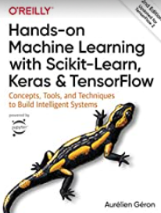
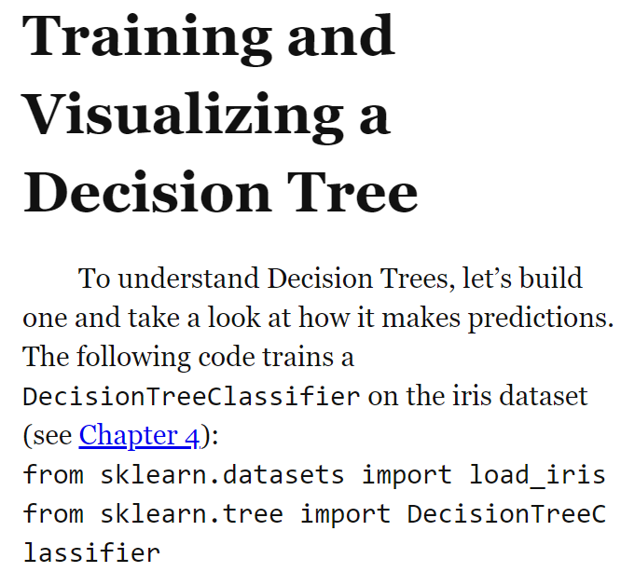
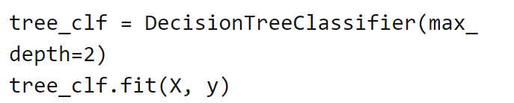
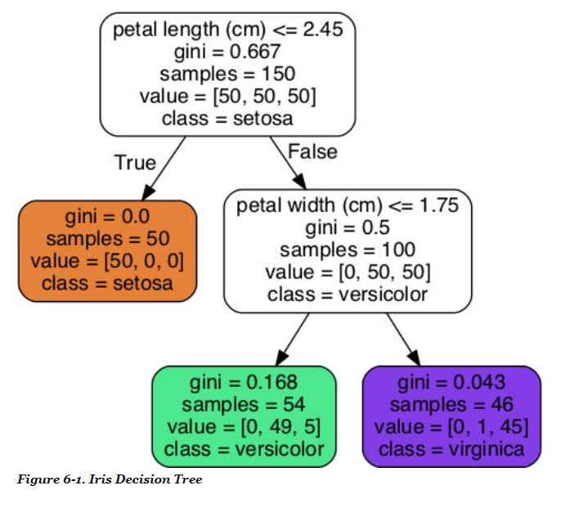
Gordon : Page 175 - 178

Slide 83
Reading Material (Optional)
Shwartz https://www.dropbox.com/s/ed9s6zyrtjgc7dk/Shwartz.pdf?dl=0
Interview Question:
https://vitalflux.com/decision-tree-algorithm-concepts-interview-questions-set-1/
http://nitin-panwar.github.io/Top-100-Data-science-interview-questions/
Video
https://www.youtube.com/watch?v=7VeUPuFGJHk
https://www.youtube.com/watch?v=wpNl-JwwplA
Homework (optional) https://www.analyticsvidhya.com/blog/2017/09/30-questions-test-tree-based-models/
Try CreditCardDefault data

Slide 84
Check Your Understanding
Create a small tree
Grow the tree
Prune the tree – when to stop (when error goes up)
Analyze the results (confusion matrix)

Slide 85
Thank You

